Slide 1
Level 6 Group 3 : Pitch Presentation
Presented on 11/10/2017
River Chick
Michael Curtis
Ryan Manthorp
Ogheneochuko Ideh

Slide 2
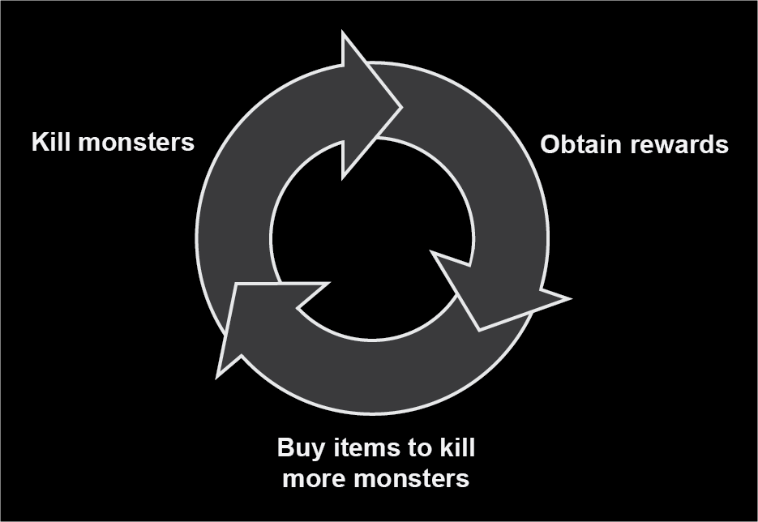
What is our brief?
Player retention is a key skill for game designers.
This is achieved through compulsion loops.
Our brief is to harness and showcase the ability of compulsion loops.
Figure 1

Slide 3
Our task
Create an experience showcasing one or more compulsion loops.
Effectively encourage player retention.
The experience must feature identifiable:
Triggers
Player actions
Variable rewards
A suitable player investment. (Eyal,2014)

Slide 4
Restrictions
No embargo on themes and motifs.
The game must be targeted towards a casual demographic.
UI must be clear & easy to navigate.
Clear affordances.
Suitable to be player able over weeks and even months.

Slide 5
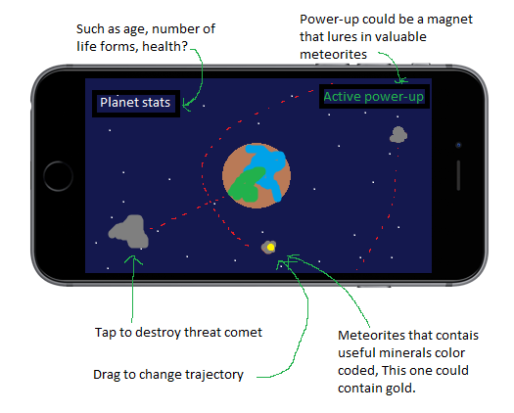
Planetary V-PET SUMULATOR CONCEPT
Figure 2

Slide 6

At The beginning
Start with a small rock
Tap that rock to make it yours

Slide 7
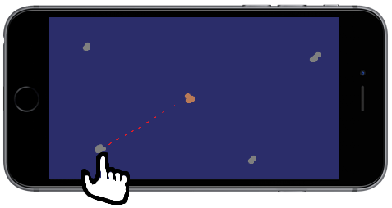
Creating the first planet
Rocks will drift in and out of frame
Select a rock and drag to change trajectory
This will build mass and the planet will grow

Slide 8
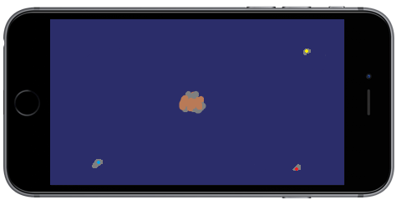
Adding minerals
Drag them the same way as standard rocks
Colour coded to determine the mineral
Also add mass to the planet

Slide 9
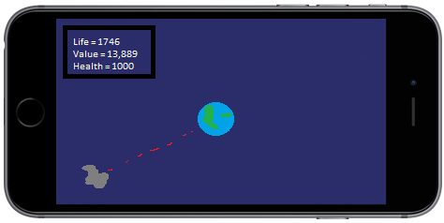
Maintenance of the planet
Soon after adding minerals the planet will have a set of stats
Also larger rocks with no minerals can harm the planet
Tap to destroy them into smaller rocks and tap to destroy them again
Or add the smaller ones as mass

Slide 10
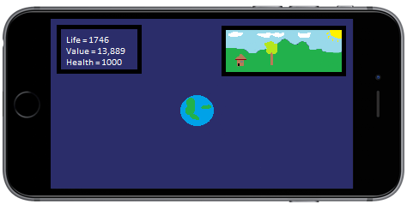
A closer look
Tapping on the planet will open a live window of a close up of the surface
This window will visually represent how the planet it doing other than just the stats
Main things it will show is lifeform and wealth

Slide 11
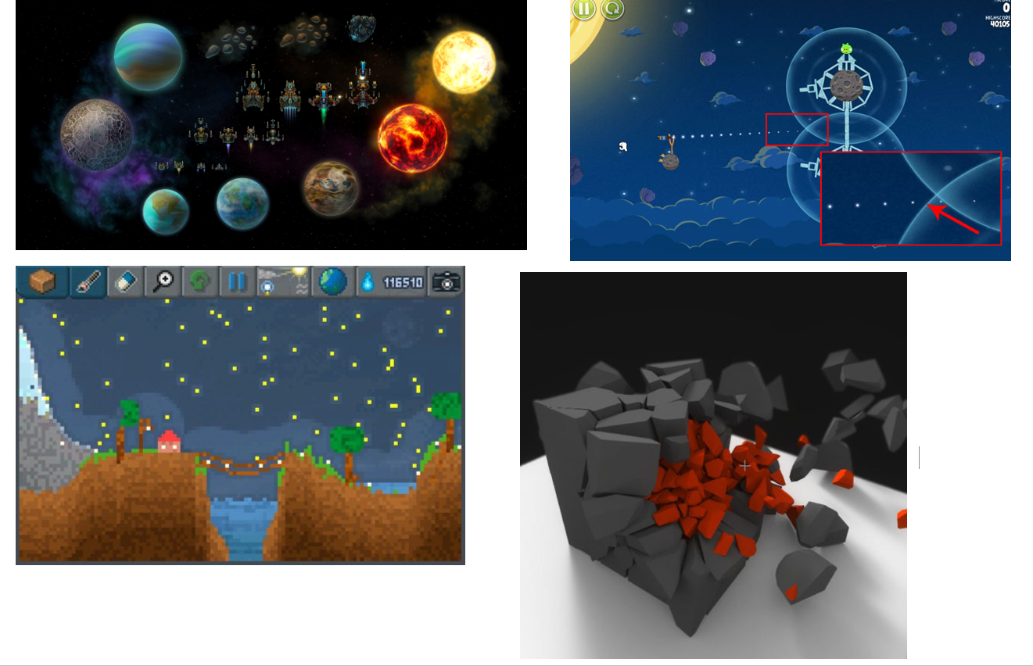
Early concept work and Prototype
Include concept art and video footage.

Slide 12
Managerial colony game concept
Insert concept art or any related imagery.
Figure 3

Slide 13
Title
Bullet points.

Slide 14
Title
Bullet points.

Slide 15
Title
Bullet points.

Slide 16
Title
Bullet points.

Slide 17
Title
Bullet points.

Slide 18
Early concept work and Prototype
Include concept art and video footage.

Slide 19
Plant Clicker game
Insert concept art or any related imagery.
Figure 4

Slide 20
Title
Bullet points.

Slide 21
Title
Bullet points.

Slide 22
Title
Bullet points.

Slide 23
Title
Bullet points.

Slide 24
Title
Bullet points.

Slide 25
Early concept work and Prototype
Include concept art and video footage.

Slide 26
Thank you for your time, questions?

Slide 27
bibliography
Figure one:
Mark A Hart . (2013). Developing the Conditions for Better Compulsion Loops in New Product Development. Available: http://oplaunch.com/blog/tag/core-compulsion-loop/. Last accessed 09/10/2017.
Eyal, N. and Hoover, R. (n.d.). Hooked.

